Slide 1
Slides for session 1
3546 Deep Learning

Slide 2
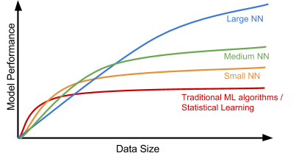
Module 1 introduction
Learning Outcomes
Describe the current applications of Deep Learning and propose new applications
Recognize and discuss the moral issues of AI
Recall key concepts from the Machine Learning course that you will need for this course
The basic structure of a neural network model
The anatomy of a neuron, including various activation functions
Neural network training techniques like weight initialization and backpropagation
Use Information Theory to reason about the quality of a model

Slide 3
introduction
Main reasons why this particular group of algorithms is taking off:
Explosion of data
Advanced computations
New algorithms

Slide 4
introduction
Big Data:
outperform traditional ML techniques when the size of the data increases
Advanced Computation:
the development of computers to handle and perform computations on big data.
Things like GPUs, TPUs, distributed computing, and cloud technologies that have democratized the field a
Algorithm Development:
Flexible nature of how neural networks are constructed
New approaches and applications of neural networks are constantly being developed and tested.
Much of the cutting-edge techniques and research is made available to the public
Like smart phones and the Internet of Things.

Slide 5
Recap of relevant ML concepts
Cost function:
Can also be called the error function
How do we reduce the error value?
Gradient Descent
Logistic regression:
classifier to give us a set of outputs or classes based on probability
when we pass the inputs through a prediction function (sigmoid) and returns a probability score between 0 and 1

Slide 6
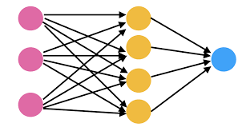
Basics of Neural Networks
An Artificial Neural Network (ANN) - or 'neural network'
A computational model
Inspired by the way biological neural networks in the human brain process information

Slide 7
Basics of Neural Networks

Slide 11
Activation function

Slide 12
Basics of Neural Networks

Slide 13
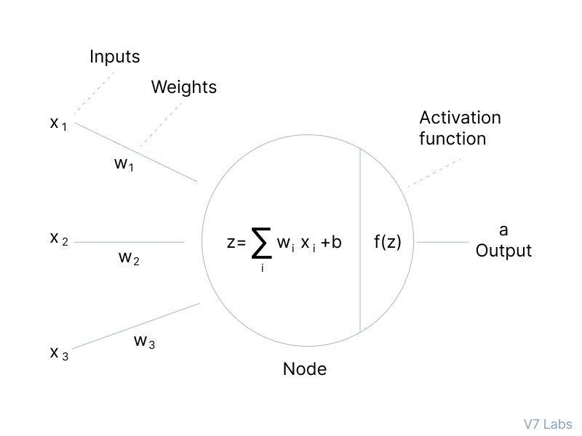
Basics of Neural Networks

Slide 14
Notes:
Sigmoid:
almost exclusively used in output layers for binary classification problems ( logistic regression- squashes all output values from 0 to 1)
when used in hidden layers, can lead us to vanishing gradient problem
gradient descent problem is when the activations get closer and closer to either zero or 1
This essentially results in gradients that are extremely small, making training very difficult and extremely slow - vanishing gradient problem.
Tanh:
Tanh is also a non-linear function (squashes inputs between a range of -1 and 1)
Tanh used for hidden layer activations (generally require additional techniques to prevent the vanishing gradient problem)
ReLU:
Rectified Linear Unit
takes a real-valued input and thresholds it at zero (replaces negative values with zero)
suffer the least from the vanishing gradient problem
Here inputs are ≤0, and 1 where inputs are >0
Often the preferred hidden layer activation function when compared to tanh (because it is less computationally expensive and extremely fast to compute)

Slide 15
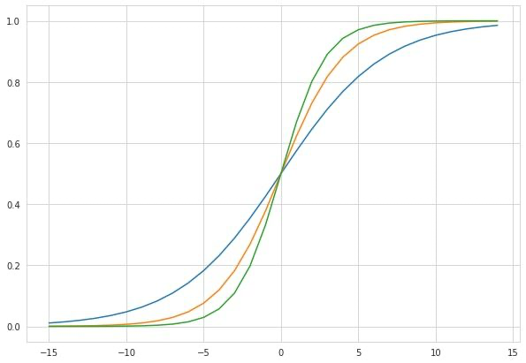
Basics of Neural Networks

Slide 16
Bias

Slide 17
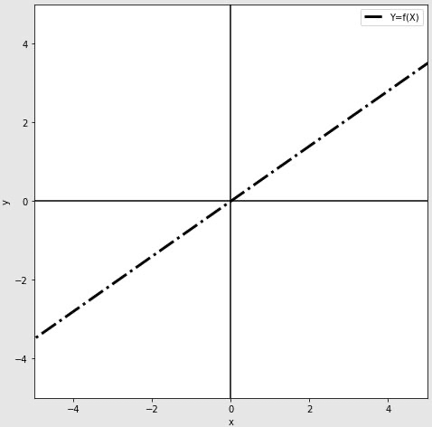
Bias

Slide 18
Bias

Slide 19
Forward propagation

Slide 20
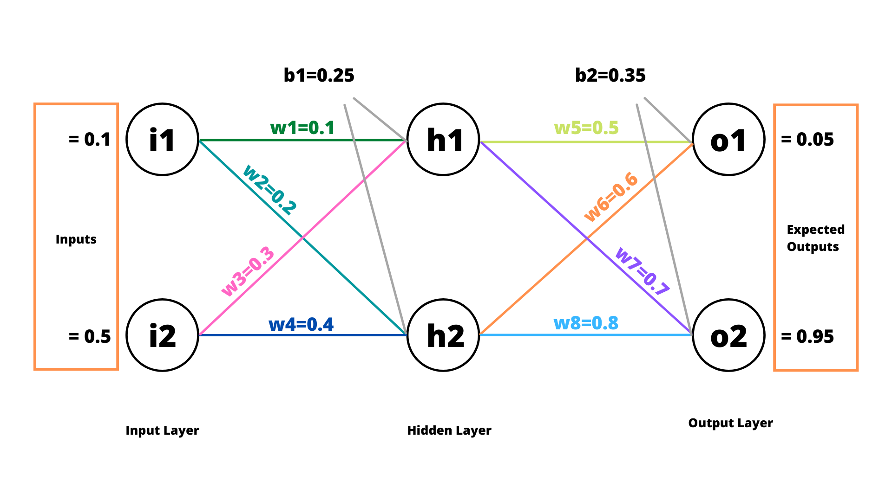
Example

Slide 21
Example

Slide 22
Example

Slide 24
Backpropagation

Slide 26
Backpropagation

Slide 27
Backpropagation

Slide 28
Backpropagation

Slide 30
Backpropagation

Slide 31
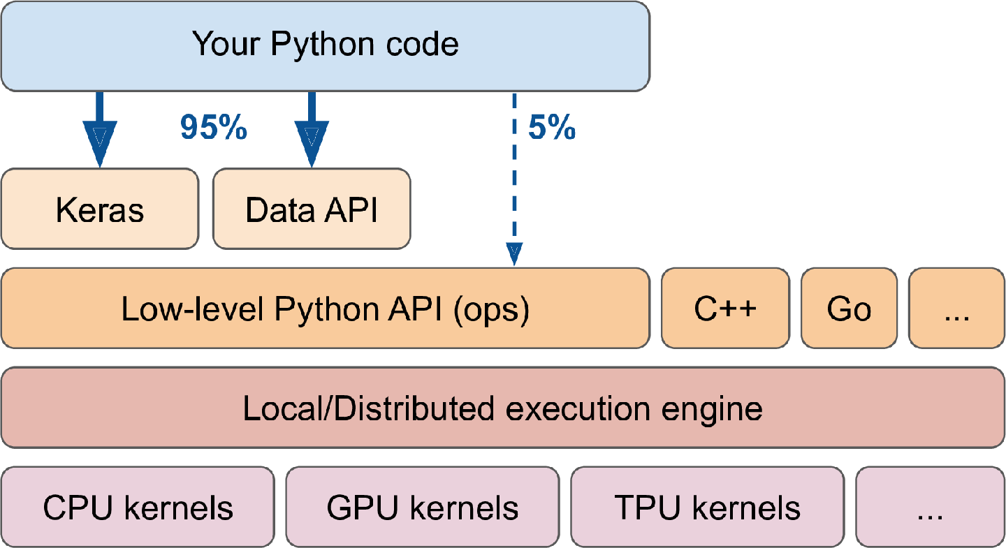
Neural Nets with Tensorflow and Keras

Slide 32
Fine-Tuning of Neural Networks

Slide 33
Fine-Tuning of Neural Networks

Slide 34
Fine-Tuning of Neural Networks

Slide 35
Fine-Tuning of Neural Networks

Slide 36
Hyperparameters
Variables which determines:
The network structure (e.g: Number of Hidden Units)
How the network is trained (e.g: Learning Rate)
Hyperparameters are set before training (before optimizing the weights and bias)

Slide 37
Hyperparameters
Number of Hidden Layers and units
How to choose a number?
Generally, keep adding layers until the test error does not improve anymore
Many hidden units within a layer with regularization techniques can increase accuracy
Smaller number of units may cause underfitting

Slide 38
Hyperparameters

Slide 39
Hyperparameters

Slide 40
Hyperparameters

Slide 41
Hyperparameters

Slide 42
Hyperparameters

Slide 43
Hyperparameters

Slide 44
Hyperparameters

